Slide 1


Ahmed Althubyani
4/18/2024

Slide 2

Outline
Executive Summary
Introduction
Methodology
Results
Conclusion
Appendix

Slide 3
Executive Summary
Summary of methodologies
Data Collection using web scraping and SpaceX API.
Exploratory Data Analysis (EDA), including data wrangling, data visualization and interactive visual analytics.
Building an interactive map with Folium
Building a Dashboard with Plotly Dash
Machine Learning Prediction.
Summary of all results
It was possible to collected valuable data from public sources.
EDA allowed to identify which features are the best to predict success of launchings.
Machine Learning Prediction showed the best model to predict which characteristics are important to drive this opportunity by the best way, using all collected data.

Slide 4
Introduction
Project background and context
SpaceX is the most successful company of the commercial space age, making space travel affordable.
The company advertises Falcon 9 rocket launches on its website, with a cost of 62 million dollars;
other providers cost upward of 165 million dollars each, much of the savings is because SpaceX can reuse the first stage.
The objective is to evaluate the viability of the new company Space Y to compete with Space X.
Therefore, if we can determine if the first stage will land, we can determine the cost of a launch.
Based on public information and machine learning models, we are going to predict if SpaceX will reuse the first stage.
Problems you want to find answers
How do variables such as payload mass, launch site, number of flights, and orbits affect the success of the first stage landing?
Does the rate of successful landings increase over the years?
What is the best algorithm that can be used for binary classification in this case?

Slide 5

Section 1

Slide 6
Methodology
Executive Summary
Data collection methodology:
Using SpaceX Rest API
Using Web Scrapping from Wikipedia
Perform data wrangling
Filtering the data
Dealing with missing values
Using One Hot Encoding to prepare the data to a binary classification
Perform exploratory data analysis (EDA) using visualization and SQL
Perform interactive visual analytics using Folium and Plotly Dash
Perform predictive analysis using classification models
Building, tuning and evaluation of classification models to ensure the best results

Slide 7
Data Collection
Data sets were collected from
Space X API ( https://api.spacexdata.com/v4/rockets/ rockets/)
Wikipedia (https://en.wikipedia.org/wiki/List_of_Falcon/_9/_and_Falcon_Heavy_launches ) using web scraping.

Slide 8
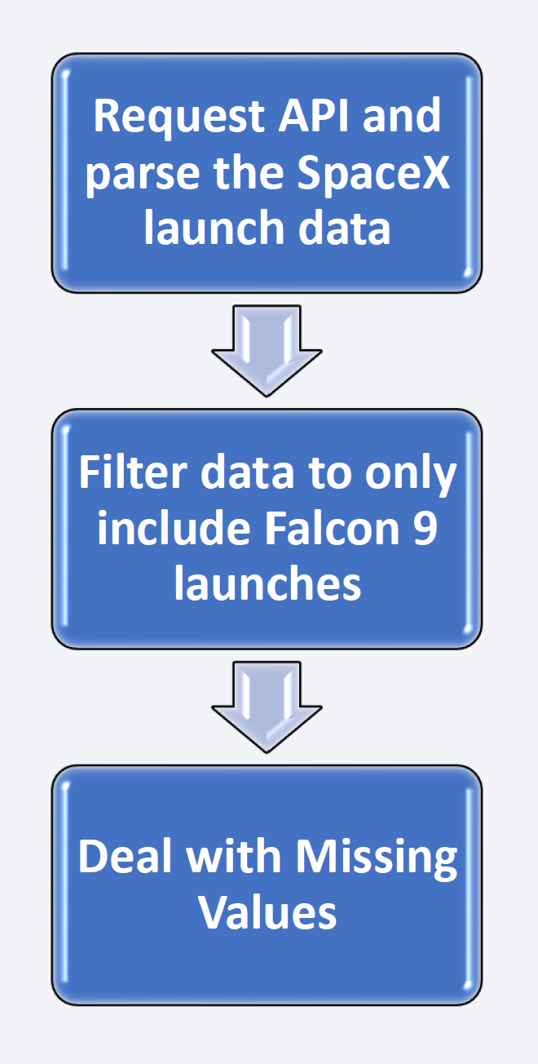
Data Collection – SpaceX API
SpaceX offers a public API from where data can be obtained and then used;
This API was used according to the flowchart beside and then data is persisted.
GitHub URL of the completed SpaceX API calls notebook https://github.com/Ahmed-Althubyani/Coursera/blob/e70dbd8144689f6ce54bb0daab3c7627ec5df377/IBM%20Data%20Science/capstone/jupyter-labs-spacex-data-collection-api.ipynb

Slide 9
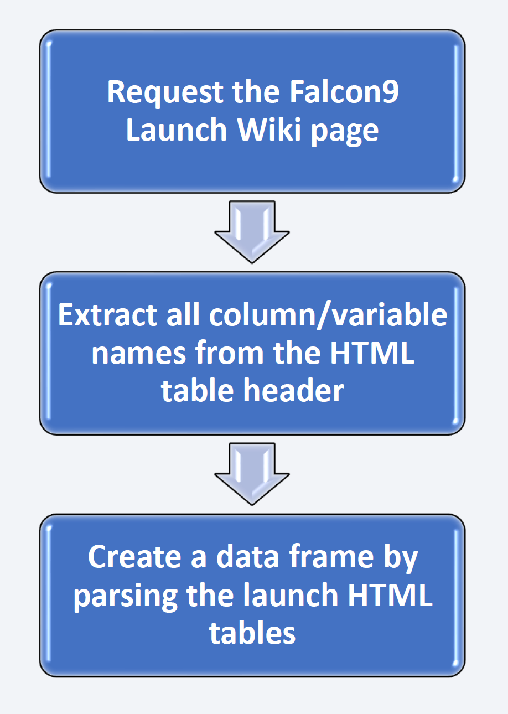
Data Collection - Scraping
Data from SpaceX launches can also be obtained from Wikipedia;
Data are downloaded from Wikipedia according to the flowchart and then persisted.
GitHub URL of the completed web scraping notebook https://github.com/Ahmed-Althubyani/Coursera/blob/e70dbd8144689f6ce54bb0daab3c7627ec5df377/IBM%20Data%20Science/capstone/jupyter-labs-webscraping.ipynb

Slide 10
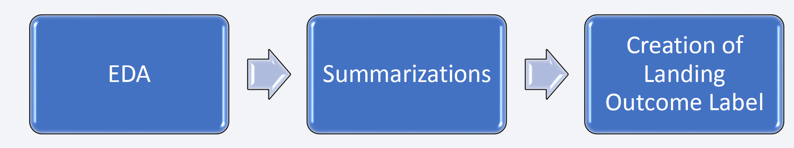
Data Wrangling
Initially some Exploratory Data Analysis (EDA) was performed on the dataset.
Then the summaries launches per site, occurrences of each orbit and occurrences of mission outcome per orbit type were calculated.
Finally, the landing outcome label was created from Outcome column.
GitHub URL of your completed data wrangling related notebooks https://github.com/Ahmed-Althubyani/Coursera/blob/e70dbd8144689f6ce54bb0daab3c7627ec5df377/IBM%20Data%20Science/capstone/labs-jupyter-spacex-Data%20wrangling.ipynb

Slide 11
EDA with Data Visualization
Charts were plotted
Flight Number vs. Payload Mass, Flight Number vs. Launch Site, Payload Mass vs. Launch Site, Orbit Type vs. Success Rate, Flight Number vs. Orbit Type, Payload Mass vs Orbit Type and Success Rate Yearly Trend
Scatter plots show the relationship between variables. If a relationship exists, they could be used in machine learning model. Bar charts show comparisons among discrete categories. The goal is to show the relationship between the specific categories being compared and a measured value. Line charts show trends in data over time (time series).
GitHub URL of your completed EDA with data visualization notebook https://github.com/Ahmed-Althubyani/Coursera/blob/e70dbd8144689f6ce54bb0daab3c7627ec5df377/IBM%20Data%20Science/capstone/edadataviz.ipynb

Slide 12
EDA with SQL
Performed SQL queries:
Displaying the names of the unique launch sites in the space mission
Displaying 5 records where launch sites begin with the string ‘CCA'
Displaying the total payload mass carried by boosters launched by NASA (CRS)
Displaying average payload mass carried by booster version F9 v1.1
Listing the date when the first successful landing outcome in ground pad was achieved
Listing the names of the boosters which have success in drone ship and have payload mass greater than 4000 but less than 6000
Listing the total number of successful and failure mission outcomes
Listing the names of the booster versions which have carried the maximum payload mass
Listing the failed landing outcomes in drone ship, their booster versions and launch site names for the months in year 2015
Ranking the count of landing outcomes (such as Failure (drone ship) or Success (ground pad)) between the date 2010-06-04 and 2017-03-20 in descending order
GitHub URL of your completed EDA with SQL notebook https://github.com/Ahmed-Althubyani/Coursera/blob/e70dbd8144689f6ce54bb0daab3c7627ec5df377/IBM%20Data%20Science/capstone/jupyter-labs-eda-sql-coursera_sqllite.ipynb

Slide 13
Build an Interactive Map with Folium
Markers, circles, lines and marker clusters were used with Folium Maps
Markers indicate points like launch sites
Circles indicate highlighted areas around specific coordinates, like NASA Johnson Space Center
Marker clusters indicates groups of events in each coordinate, like launches in a launch site
Lines are used to indicate distances between two coordinates.
GitHub URL of your completed interactive map with Folium map https://github.com/Ahmed-Althubyani/Coursera/blob/e70dbd8144689f6ce54bb0daab3c7627ec5df377/IBM%20Data%20Science/capstone/lab_jupyter_launch_site_location.ipynb

Slide 14
Build a Dashboard with Plotly Dash
Launch Sites Dropdown List:
Added a dropdown list to enable Launch Site selection.
Pie Chart showing Success Launches (All Sites/Certain Site):
Added a pie chart to show the total successful launches count for all sites and the Success vs. Failed counts for the site, if a specific Launch Site was selected.
Slider of Payload Mass Range:
Added a slider to select Payload range.
Scatter Chart of Payload Mass vs. Success Rate for the different Booster Versions:
Added a scatter chart to show the correlation between Payload and Launch Success.
GitHub URL of your completed Plotly Dash lab https://github.com/Ahmed-Althubyani/Coursera/blob/e70dbd8144689f6ce54bb0daab3c7627ec5df377/IBM%20Data%20Science/capstone/spacex_dash_app.py

Slide 15
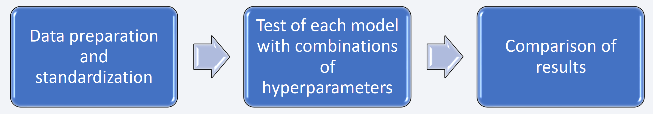
Predictive Analysis (Classification)
Four classification models were compared: logistic regression, support vector machine, decision tree and k nearest neighbors.
GitHub URL of your completed predictive analysis lab https://github.com/Ahmed-Althubyani/Coursera/blob/e70dbd8144689f6ce54bb0daab3c7627ec5df377/IBM%20Data%20Science/capstone/SpaceX_Machine%20Learning%20Prediction_Part_5.ipynb

Slide 16
Results
Exploratory data analysis results
Interactive analytics demo in screenshots
Predictive analysis results

Slide 17

Section 2

Slide 18
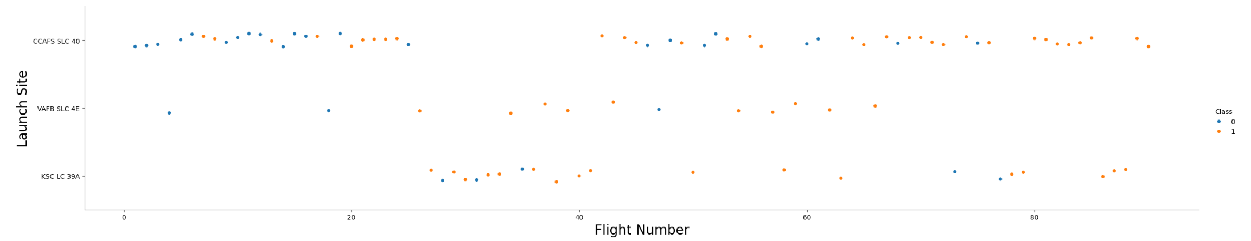
Flight Number vs. Launch Site
The earliest flights all failed while the latest flights all succeeded.
The CCAFS SLC 40 launch site has about a half of all launches.
VAFB SLC 4E and KSC LC 39A have higher success rates.
It can be assumed that each new launch has a higher rate of success.

Slide 19
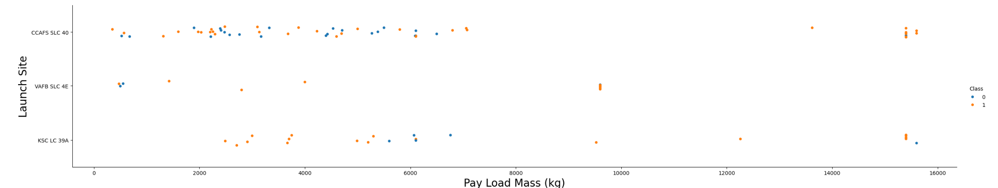
Payload vs. Launch Site
Payloads over 9,000kg (about the weight of a school bus) have excellent success rate;
Payloads over 12,000kg seems to be possible only on CCAFS SLC 40 and KSC LC 39A launch sites.

Slide 20
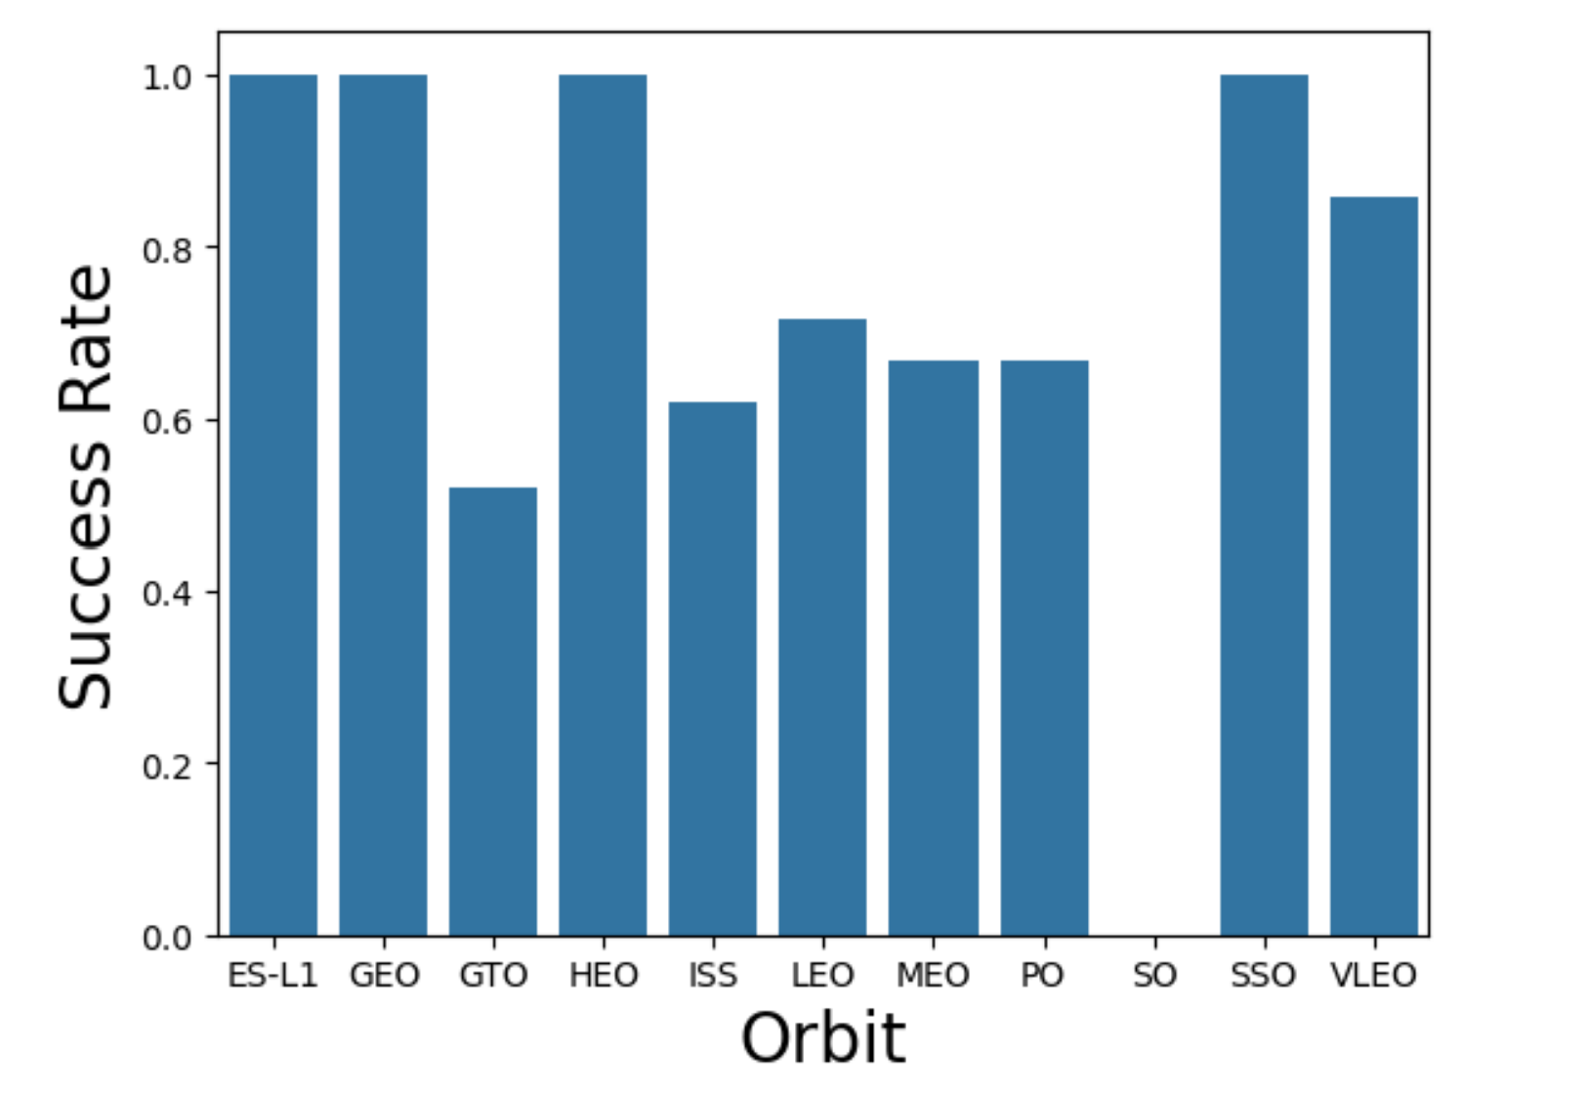
Success Rate vs. Orbit Type
Orbits with 100% success rate:
ES-L1, GEO, HEO, SSO
Orbits with 0% success rate:
SO
Orbits with success rate between 50% and 85%:
GTO, ISS, LEO, MEO, PO

Slide 21
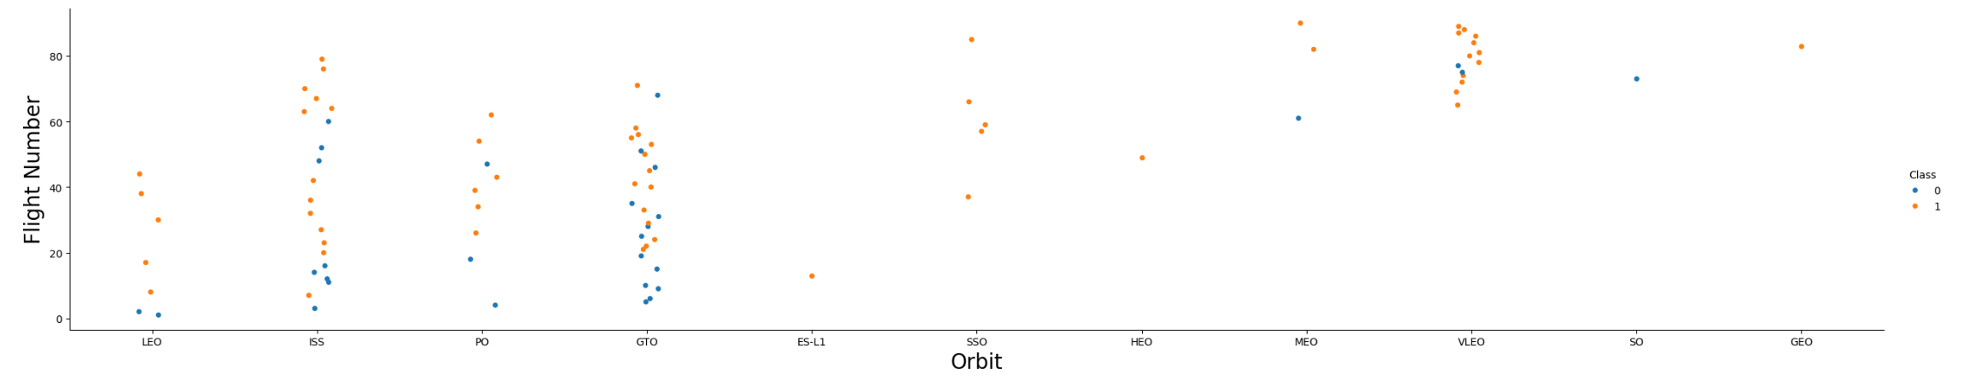
Flight Number vs. Orbit Type
Apparently, success rate improved over time to all orbits;
VLEO orbit seems a new business opportunity, due to recent increase of its frequency.

Slide 22
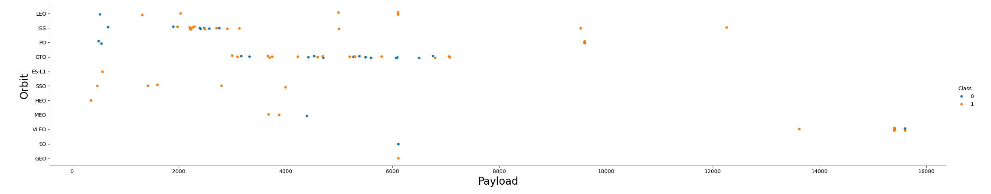
Payload vs. Orbit Type
Apparently, there is no relation between payload and success rate to orbit GTO;
ISS orbit has the widest range of payload and a good rate of success;
There are few launches to the orbits SO and GEO.

Slide 23
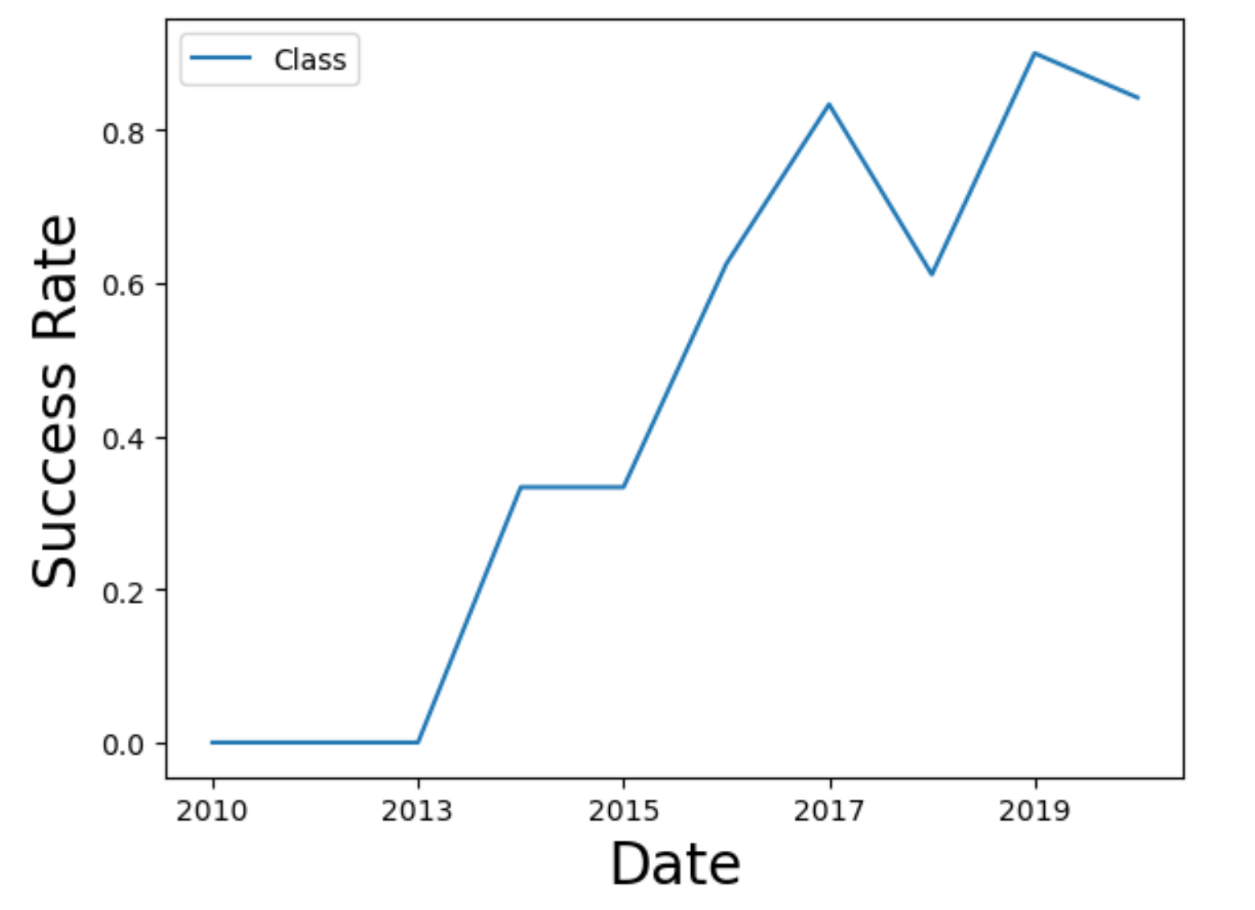
Launch Success Yearly Trend
The success rate since 2013 kept increasing till 2020.

Slide 24
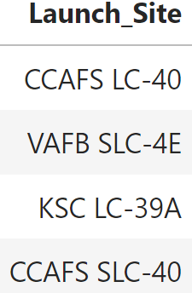
All Launch Site Names
Displaying the names of the unique launch sites in the space mission.

Slide 25
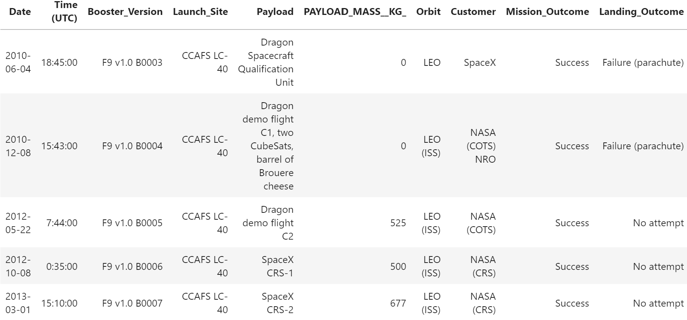
Launch Site Names Begin with 'CCA'
5 records where launch sites begin with `CCA`

Slide 26
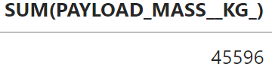
Total Payload Mass
Calculate the total payload carried by boosters from NASA

Slide 27
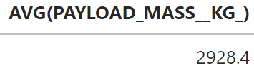
Average Payload Mass by F9 v1.1
Calculate the average payload mass carried by booster version F9 v1.1

Slide 28
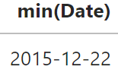
First Successful Ground Landing Date
Find the dates of the first successful landing outcome on ground pad

Slide 29
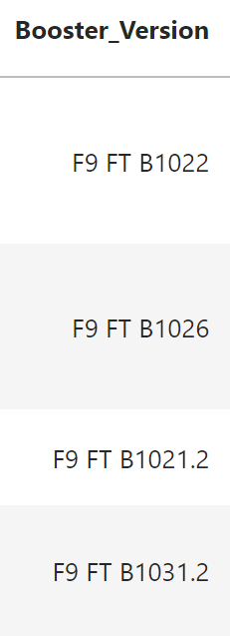
Successful Drone Ship Landing with Payload between 4000 and 6000
List the names of boosters which have successfully landed on drone ship and had payload mass greater than 4000 but less than 6000

Slide 30
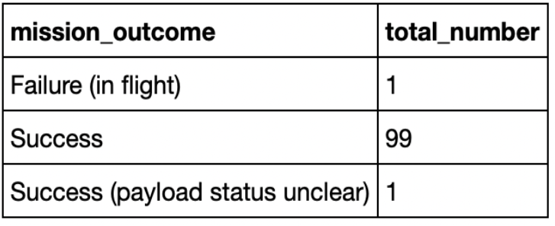
Total Number of Successful and Failure Mission Outcomes
Calculate the total number of successful and failure mission outcomes

Slide 31
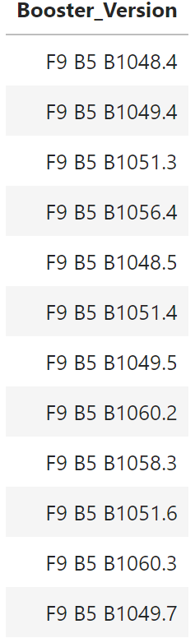
Boosters Carried Maximum Payload
List the names of the booster which have carried the maximum payload mass

Slide 32
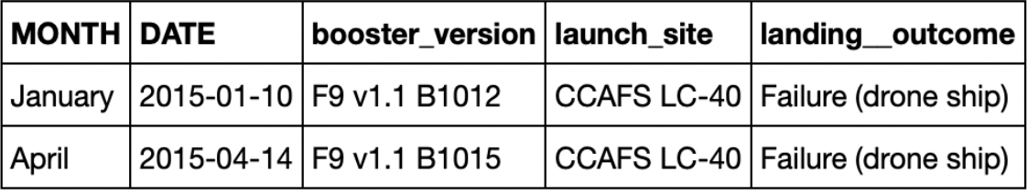
2015 Launch Records
List the failed landing_outcomes in drone ship, their booster versions, and launch site names for in year 2015

Slide 33
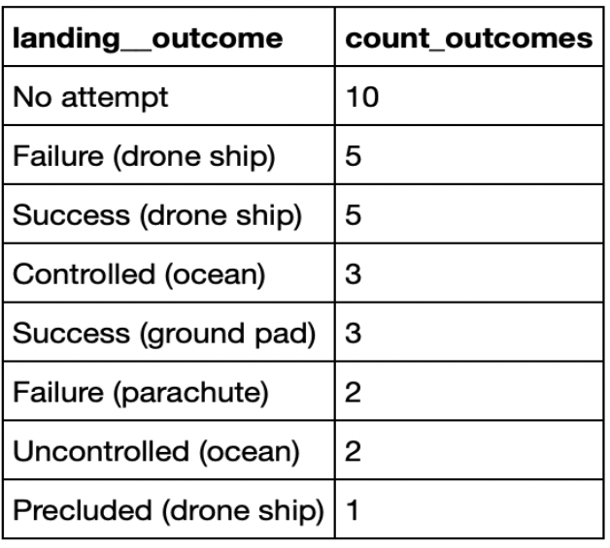
Rank Landing Outcomes Between 2010-06-04 and 2017-03-20
Rank the count of landing outcomes (such as Failure (drone ship) or Success (ground pad)) between the date 2010-06-04 and 2017-03-20, in descending order

Slide 34

Section 3

Slide 35
All launch sites
Launch sites are near sea, probably by safety, but not too far from roads and railroads.

Slide 36
Color-labeled launch records on the map
From the color-labeled markers we should be able to easily identify which launch sites have relatively high success rates.
Green Marker = Successful Launch
Red Marker = Failed Launch
Launch Site KSC LC-39A has a very high Success Rate.

Slide 37
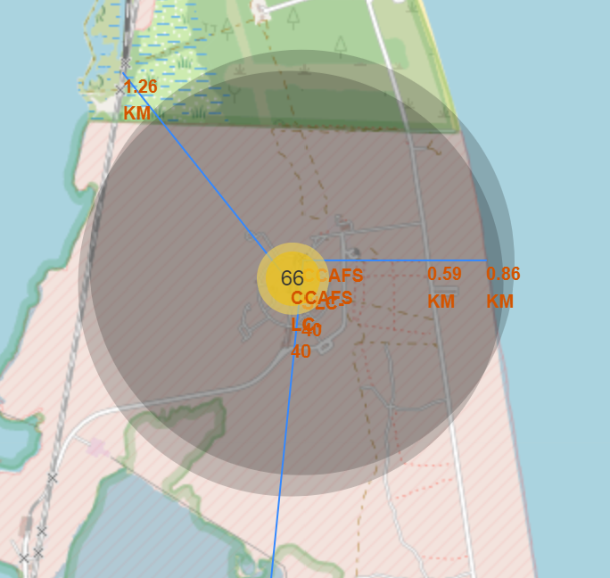
Distance from the launch site CCAFS SLC-40 to its proximities
From the visual analysis of the launch site CCAFS SLC-40 we can clearly see that it is:
relatively close to railway (1.26 km)
relatively close to highway (0.59 km)
relatively close to coastline (0.86 km)

Slide 38

Section 4

Slide 39
Launch success count for all sites
The chart clearly shows that from all the sites, KSC LC-39A has the most successful launches.

Slide 40
Launch site with highest launch success ratio
KSC LC-39A has the highest launch success rate (76.9%) with 10 successful and only 3 failed landings.

Slide 41
<Dashboard Screenshot 3>
The charts show that payloads between 2000 and 5500 kg have the highest success rate.

Slide 42

Section 5

Slide 43
Classification Accuracy
Scores and Accuracy of the Test Set
Based on the scores of the Test Set, we can not confirm which method performs best.
Same Test Set scores may be due to the small test sample size (18 samples). Therefore, we tested all methods based on the whole Dataset.
The scores of the whole Dataset confirm that the best model is the Decision Tree Model. This model has not only higher scores, but also the highest accuracy.
Scores and Accuracy of the Entire Data Set

Slide 44
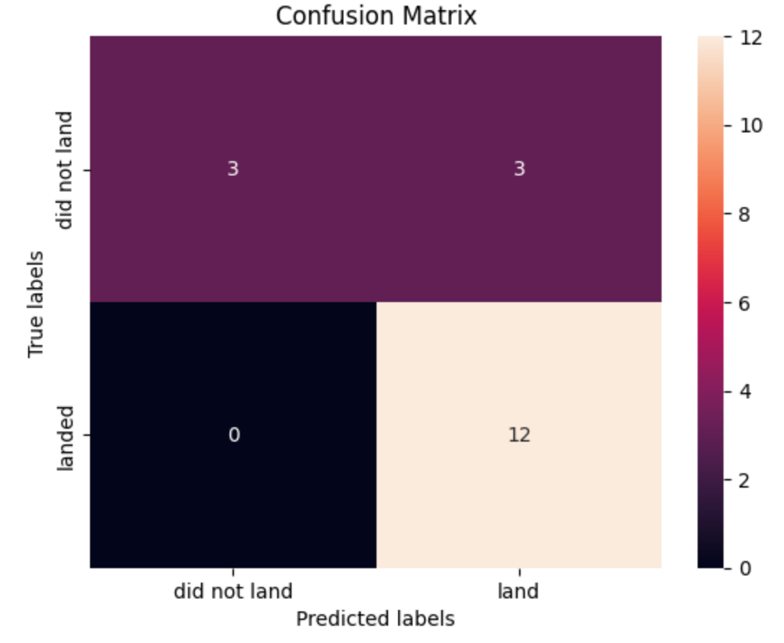
Confusion Matrix
Examining the confusion matrix, we see that logistic regression can distinguish between the different classes. We see that the major problem is false positives.

Slide 45
Conclusions
Decision Tree Model is the best algorithm for this dataset.
Launches with a low payload mass show better results than launches with a larger payload mass.
Most of launch sites are in proximity to the Equator line and all the sites are in very close proximity to the coast.
The success rate of launches increases over the years.
KSC LC-39A has the highest success rate of the launches from all the sites.
Orbits ES-L1, GEO, HEO and SSO have 100% success rate.

Slide 46
Appendix
Special Thanks to:
Instructors
Coursera
IBM

Slide 47


